Slide 1
SE 577 Software Architecture Architectural Styles

Slide 2
Acknowledgement
Material from several sources including:
D. Garlan and M. Shaw, “An Introduction to Software Architecture”, CMU-CS-94-166
R.N. Taylor, N. Medvidovic, and E.M. Dashofy. Software Architecture: Foundations, Theory and Practice, Wiley.

Slide 3
Software Architecture - Ingredients
Most definitions of software architecture generally talk about
What are the important “architectural” components
What are the connectors between the architectural components
What patterns, constraints, or decisions govern the restrictions on connecting the architectural components.
Think about it, not all ways to connect architecture components together are equally good.

Slide 4
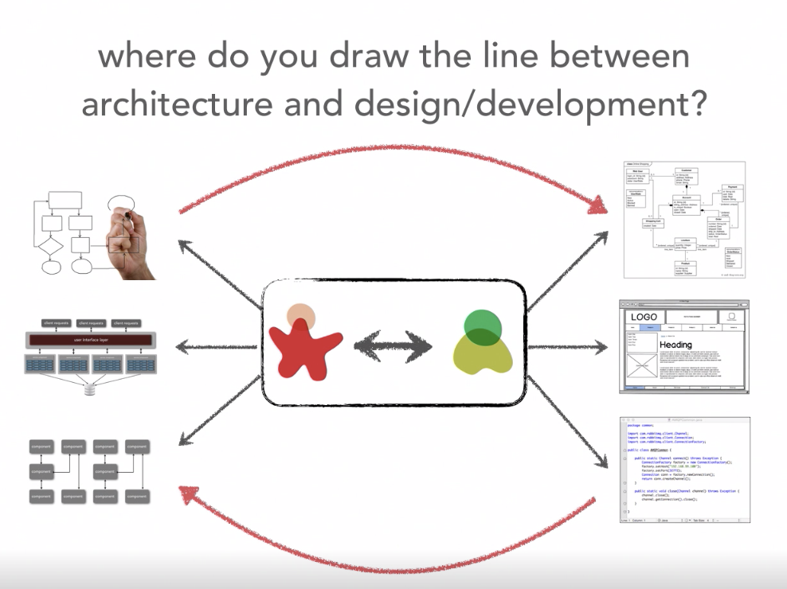
We can also look at this non- hierarchical… The relation between the architecture and design spaces
Ref: Neil Ford & Mark Richards Software Architecture Fundamentals
Bi-Directional Influence
Architecture Stuff
Design Stuff
Constituent Collaboration

Slide 5
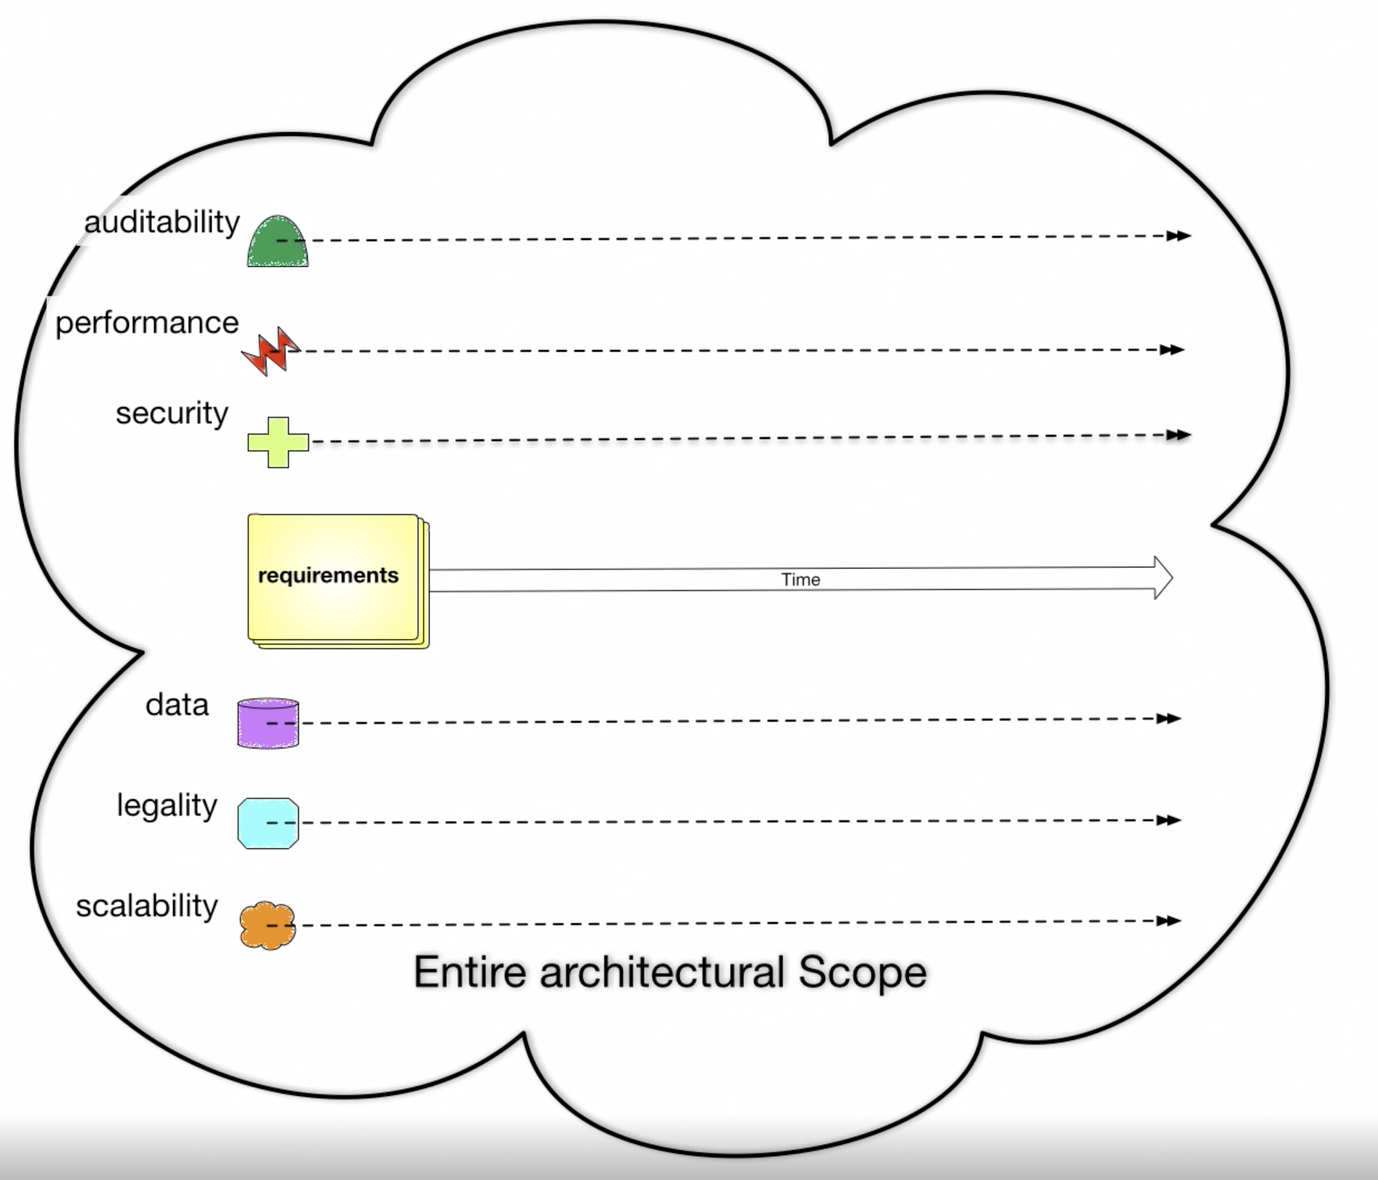
Architecture has a broader scope than design
Ref: Neil Ford & Mark Richards Software Architecture Fundamentals
Broader Architecture Focus
Design Focus

Slide 6
System Quality Attributes
Ref: https://en.wikipedia.org/wiki/List_of_system_quality_attributes
accessibility
accountability
accuracy
adaptability
administrability
affordability
agility
auditability
autonomy
availability
compatibility
composability
configurability
correctness
credibility
customizability
debugability
degradability
determinability
demonstrability
dependability
scalability
seamlessness
self-sustainability
serviceability securability
simplicity
stability
standards compliance
survivability
sustainability
tailorability
testability
timeliness
traceability
transparency
ubiquity
understandability
upgradability
vulnerability
usability
deployability
discoverability [Erl]
distributability
durability
effectiveness
efficiency
evolvability
extensibility
failure transparency
fault-tolerance
fidelity
flexibility
inspectability
installability
integrity
interchangeability
interoperability [Erl]
learnability
maintainability
manageability
mobility
modifiability
modularity
operability
orthogonality
portability
precision
predictability
process capabilities
producibility
provability
recoverability
relevance
reliability
repeatability
reproducibility
resilience
responsiveness
reusability [Erl]
robustness
safety
These attributes and the tradeoffs associated with them influence architecture and design decisions

Slide 7
System Quality Attributes
Ref: https://en.wikipedia.org/wiki/List_of_system_quality_attributes
Although there are many quality attributes, certain ones tend to appear again and again that impact the design and architecture of systems
Modularity
Maintainability
Testability
Availability
Deployability
Reliability
Scalability
Evolvability
Affordability
++ FEASIBILITY ++

Slide 8
Blockchain Demo – Quality Attributes and Design
Kubernetes
Blockchain UI Pod
Blockchain UI Service
container
Localhost:30133
/
GoLang Solver API Pod
GoLang Solver Service
/api/go
container
Browser
/api/node
NODE Solver Service
NODE Solver API Pod
HA Proxy Ingress Controller
/api/kotlin
container
Kotlin Solver Service
Kotlin Solver API Pod
/api/rust
container
RUST Solver Service
RUST Solver API Pod
container

Slide 9
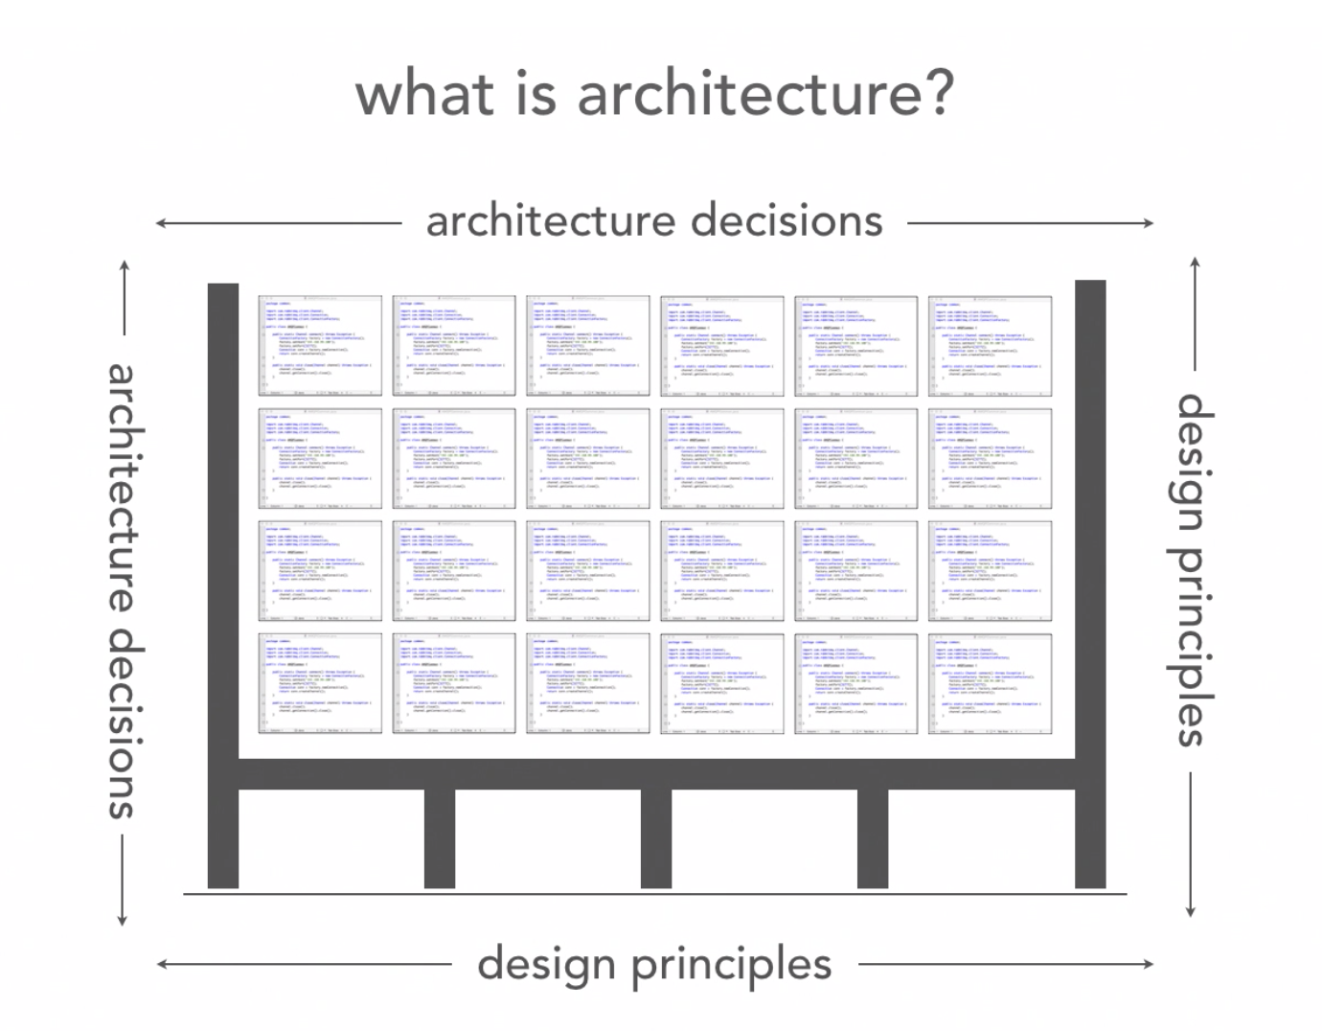
The structure of the source code should not be determined arbitrarily
Ref: Neil Ford & Mark Richards Software Architecture Fundamentals
What holds up the source code structure?

Slide 10
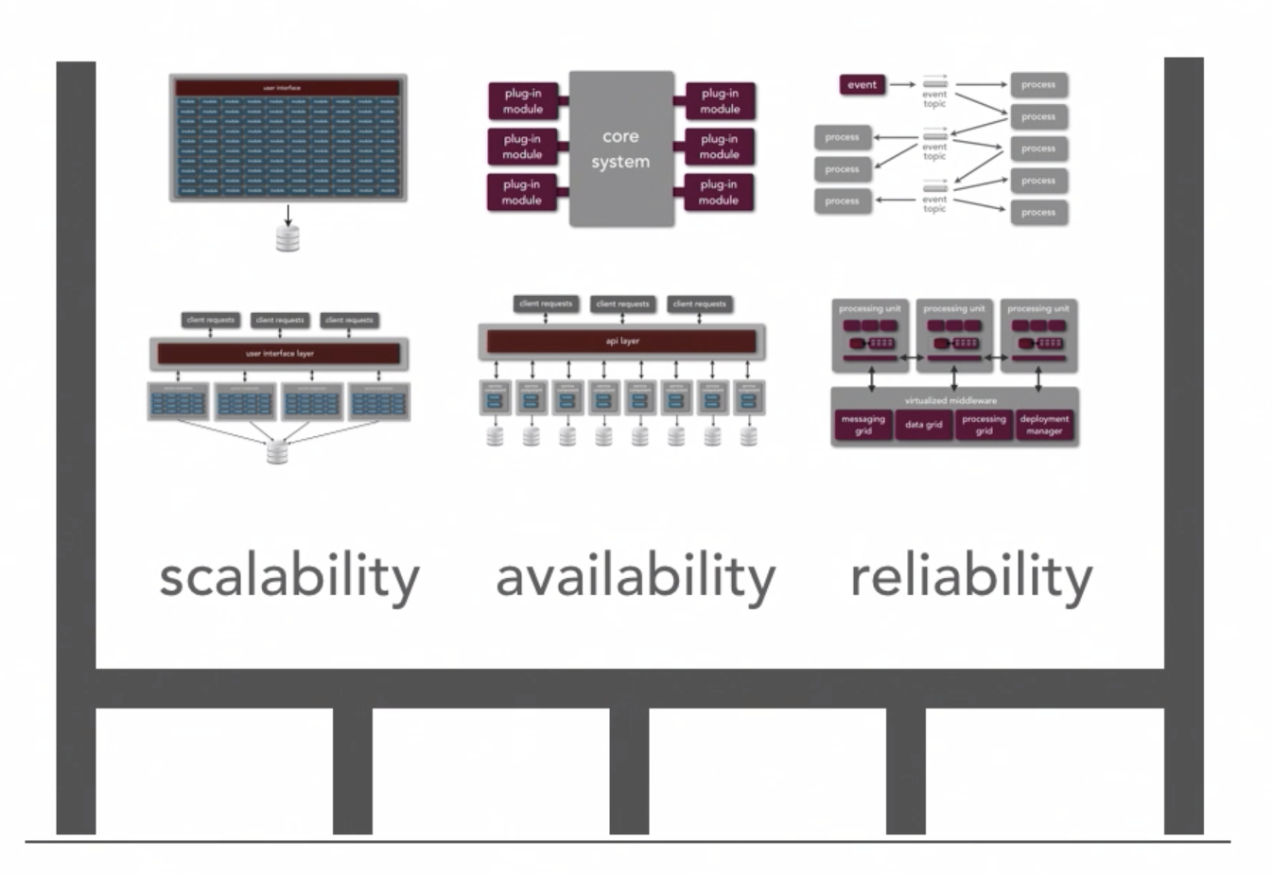
Starting with understanding the structure of the system
Ref: Neil Ford & Mark Richards Software Architecture Fundamentals
We can use architecture styles and patterns to structure the system
Needed quality attributes will also help dictate the system structure

Slide 11
Back to Architecture Basics
When I introduced the vocabulary of architecture components
Terms used: Components, Connectors, Structures, and so on.
I like to think about architecture in terms of laying out the foundation for design
What design decisions do we need to make, and/or what structures do we need to document in order to realize all of the constraints imposed on the system
Constraints typically come from the non-functional requirements – time to market, budget, technology standards, skillsets, etc
Good architecture makes important decisions early and defers less-important decisions to later
Do we really need to pick the database technology up front?
How much should the fact that the system is web-based influence the overall design, can we abstract this for now and specify it later?

Slide 12
Architecture and Design Patterns
Architecture Style
Defines the vocabulary of the components and connectors in a software architecture and the constraints on how they can be combined.
Example: Pipe and Filter
Architecture Patterns
Focus is on the organization of the overall system
An instance of an architecture style
Design Patterns
Focus is on the organization of a block of code

Slide 13
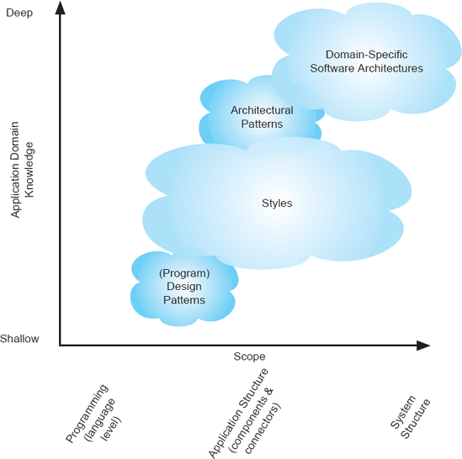
Software Architecture Landscape
Also known as a reference architecture, is the set of principal design decisions that are simultaneously applicable to multiple related systems, typically within an application domain, with explicitly defined points of variation
An architectural pattern is a named collection of architectural design decisions that are applicable to a recurring design problem, parameterized to account for different software development contexts in which that problem appears.
.
An architectural style is a named collection of architectural design decisions that (1) are applicable in a given development context, (2) constrain architectural design decisions that are specific to a particular system within that context, and (3) elicit beneficial qualities in each resulting system.
R.N. Taylor, N. Medvidovic, and E.M. Dashofy. Software Architecture: Foundations, Theory and Practice, Wiley.

Slide 14
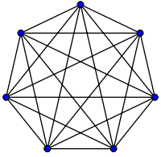
Remember every system has an architecture – Our first architecture pattern
Lets call this the “ball of mud” architecture pattern – it meets the definition Constraints of this pattern – every component is allowed to directly talk to every other component – in other words – there are no constraints Thus, introducing a new component, allows for an additional n-1 connections where n is the total number of components

Slide 15
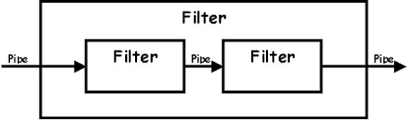
Another Architecture Pattern – this one a little more realistic
The Pipe-and-Filter is a classic architecture pattern – its actually the basis for some of the goodness in functional programming and other design patterns such as the builder pattern
Components are the filters – all inputs are provided by pipes, all transformations are done by filters. Filters are stateless, all transformations are based on pipe inputs
The filters can ingest inputs and produce outputs atomically or via streaming

Slide 16
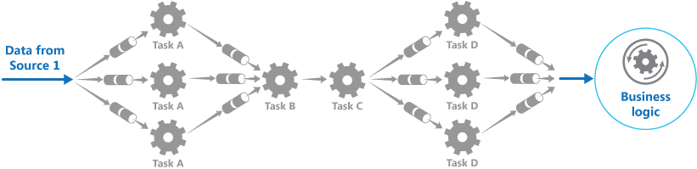
Another Architecture Pattern – this one a little more realistic
The Pipe-and-Filter is also powerful because there can be special filters that split data and other filters that coordinate merging of data
This enables large scale and concurrency

Slide 17
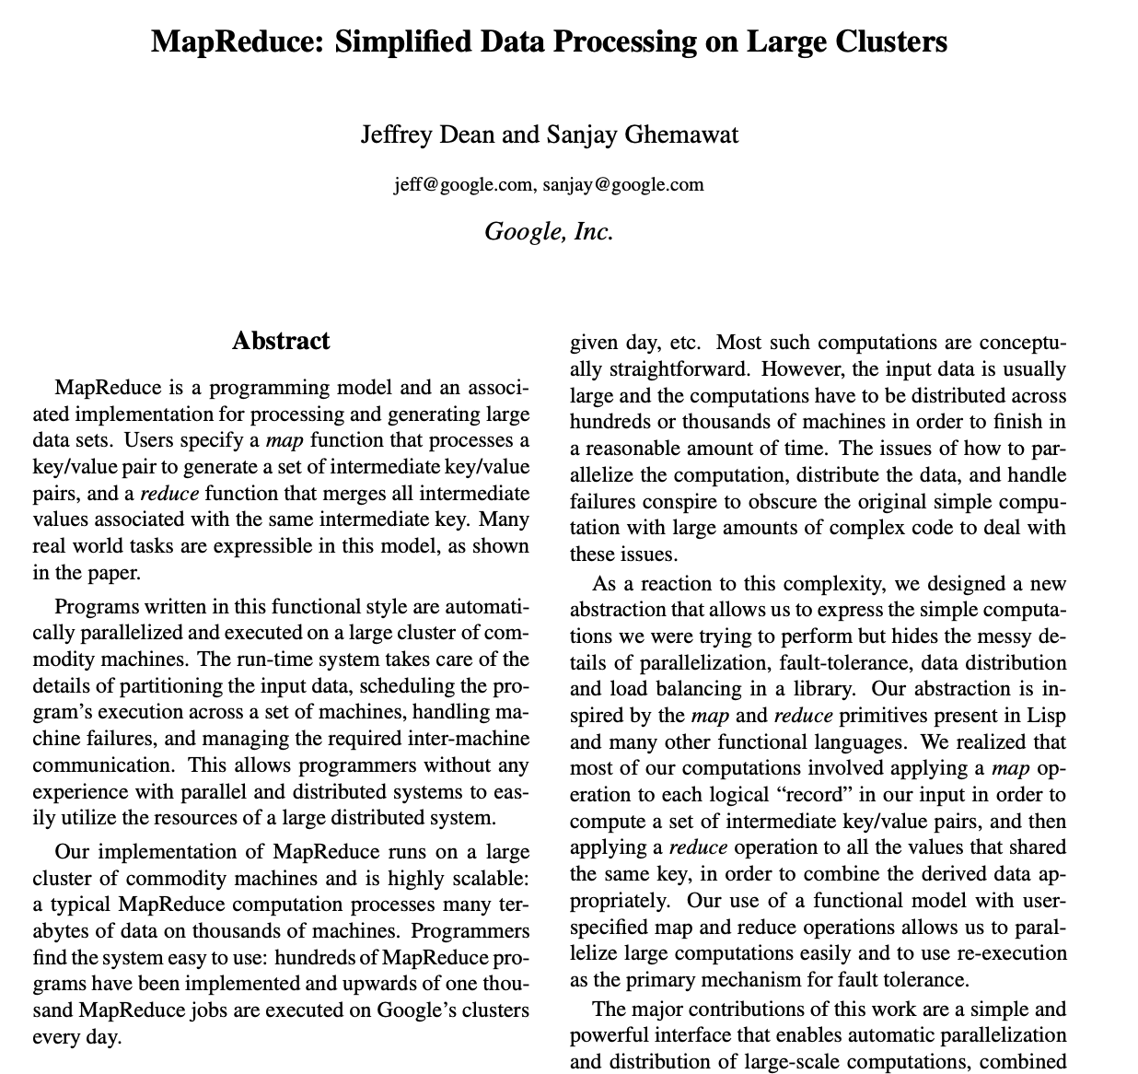
Pipe and Filter is very useful in the real world
This is the seminal paper by google on MapReduce – basically an at scale implementation of pipe-and-filter

Slide 18
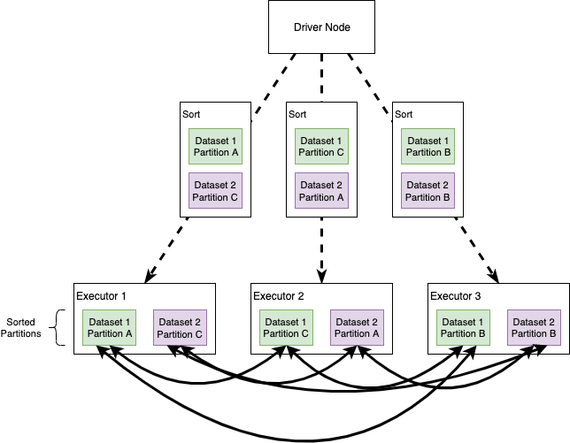
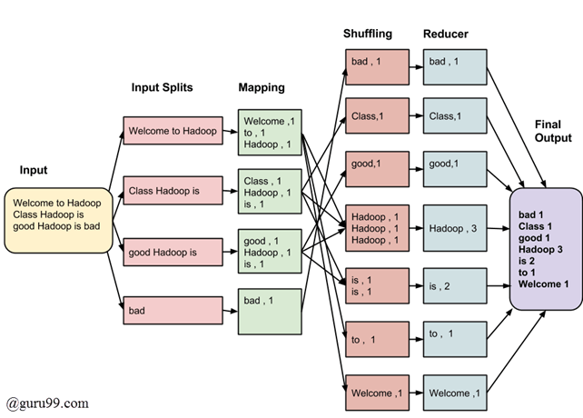


Pipe-and-Filter used as at scale data pipelines

Slide 19
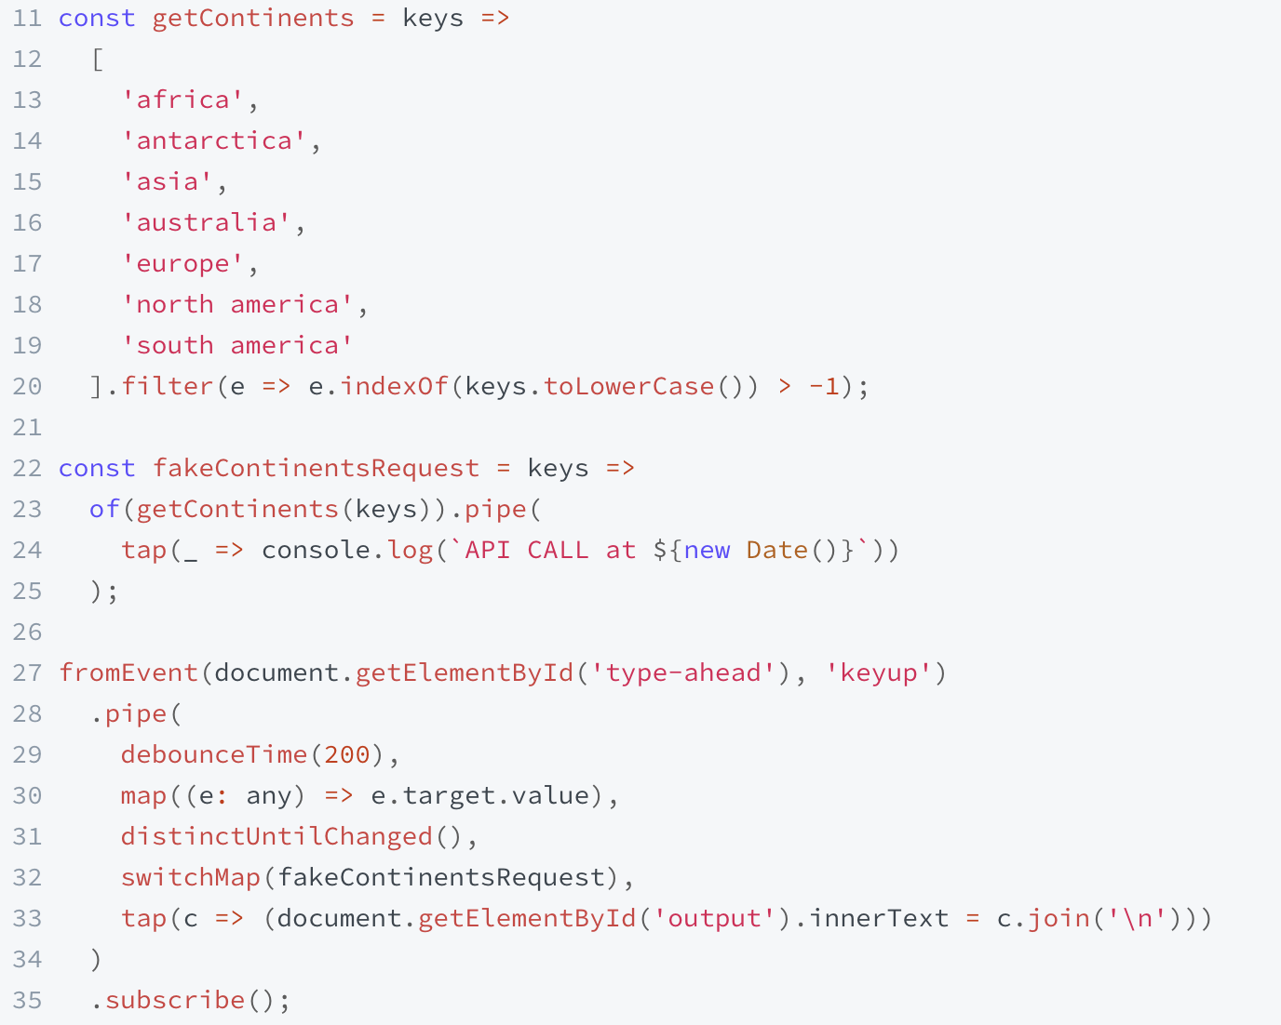
Pipe-and-Filter – Functional Programming
Demo at: https://www.learnrxjs.io/learn-rxjs/recipes/type-ahead

Slide 20
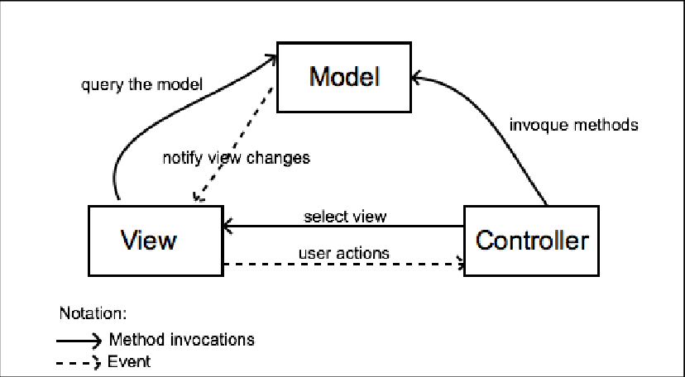
An example of an architecture pattern – MVC (Model/View/Controller)
MVC is a more realistic example of an architecture style
View is passive, reacts to changes – updates data based on model events, updates presentation based on controller reacting to user behavior
Application state fully managed by model

Slide 21
Sidebar – Architecture Style versus Architecture Pattern?
If you study classic references for software architecture you will see that architecture styles and patterns are considered different things…
While we can form a general understanding of their differences based on abstraction (e.g., pipe/filter vs MVC)…
In practice, they can generally be used interchangeably – Ill generally just call them architecture styles

Slide 22
Architecture Styles
Architecture Styles Define and Constrain the:
The components of the solution
What are the major computational units of the solution
Eg., Security, Data Access, Protocol Handling, …
The connectors of the solution
How are the interactions between the components realized
Eg., procedure calls, network calls, events, broadcasts, …
The properties of the solution
What are the quality attributes and non-functional requirements
Eg., pre/post conditions, availability specifications, interface semantics, …

Slide 23
Architecture decisions and design principles also influence the system structure
Ref: Neil Ford & Mark Richards Software Architecture Fundamentals
Things that make the solution performant, scalable, modular, maintainable, testable, and so on
Things that make the code performant, scalable, modular, maintainable, testable, and so on

Slide 24
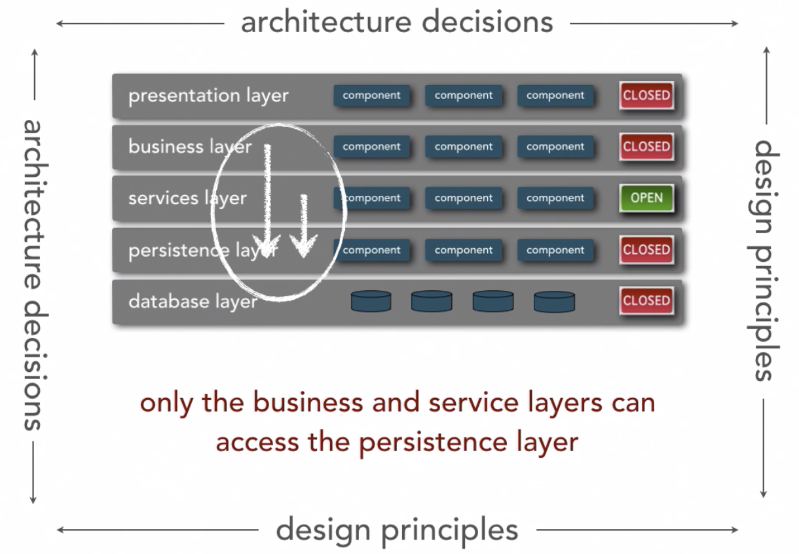
Architecture principal example
Ref: Neil Ford & Mark Richards Software Architecture Fundamentals
Reduces coupling by only allowing components to communicate to adjacent layers or within the same layer

Slide 25
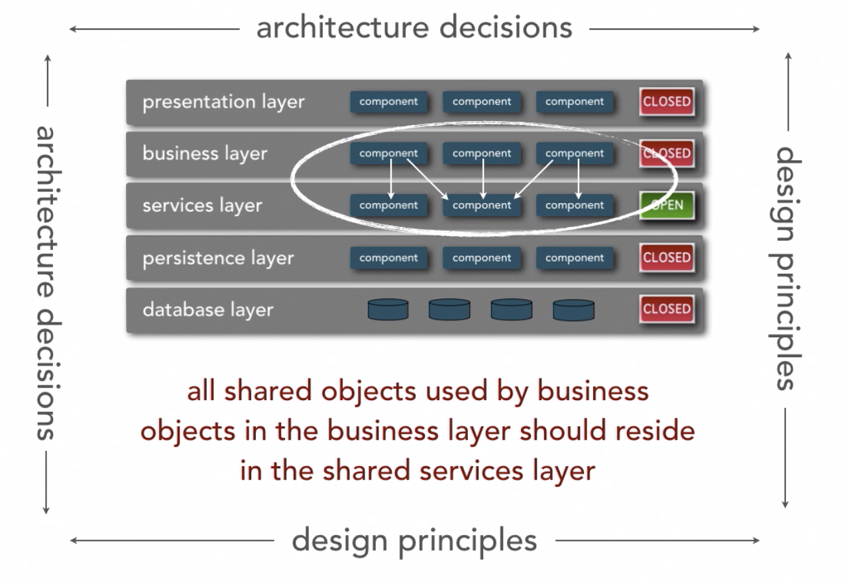
Another architecture principal example…
Ref: Neil Ford & Mark Richards Software Architecture Fundamentals
Implies reuse emphasis will be in the services layer

Slide 26
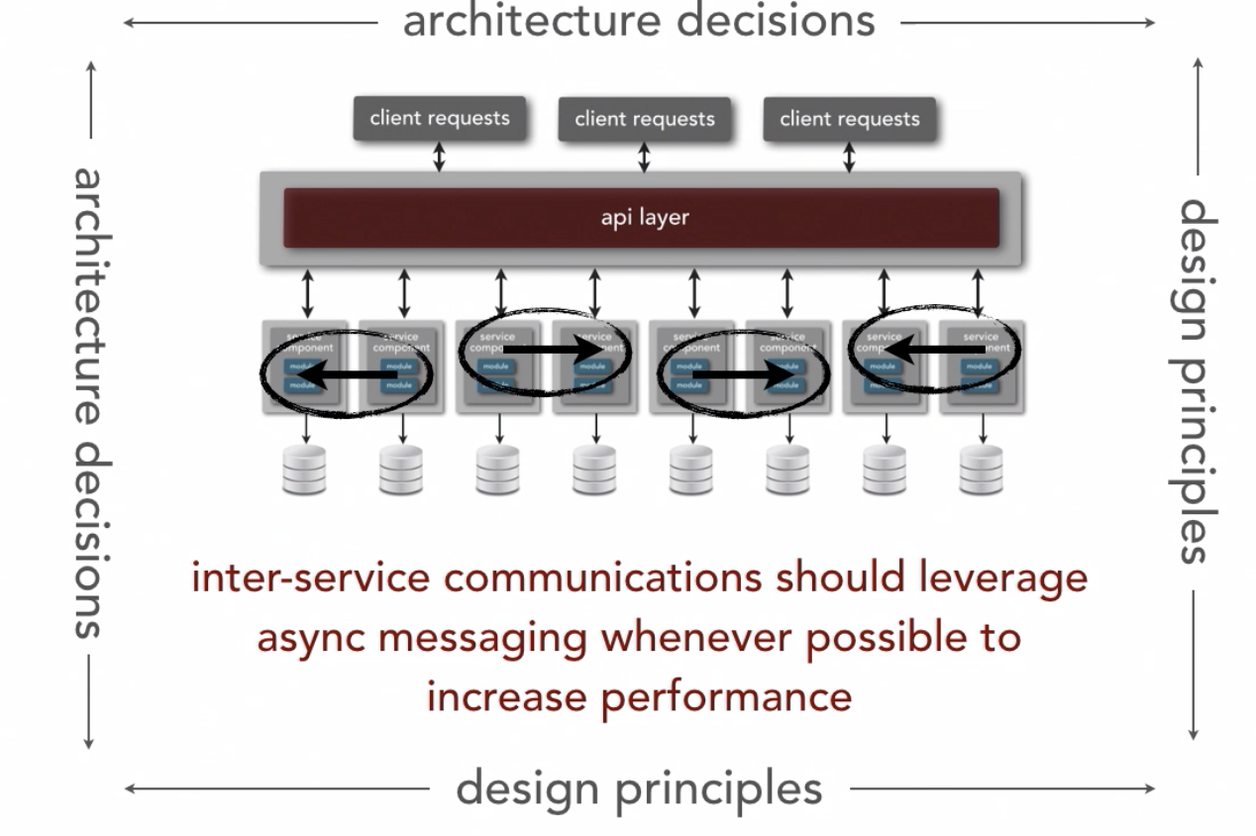
Design principles can impact many platform and technology aspects
Ref: Neil Ford & Mark Richards Software Architecture Fundamentals
A design decision that has been shown to have good performance characteristics…
Tradeoff is introduction of complexity

Slide 27
Architectural Styles

Slide 28
Architectural Styles
An architectural style describes a method of construction and a set of features that make it notable.

Slide 29
Architectural Styles
An architectural style describes a method of construction and a set of features that make it notable.
A software architectural style defines a family of systems in term of structural organization. Components and connectors are combined in specific ways and reflect design decisions given the objectives and constraints of the problem to be solved.

Slide 30
Basic Properties of Styles
The design elements
Component and connector types; data elements (e.g., pipes, filters, objects, servers)
The configuration rules
Topological constraints that determine allowed compositions of elements (e.g., a component may be connected to at most two other components)
A semantic interpretation
Compositions of design elements have well-defined meanings

Slide 31
Benefits of Using Styles
Design reuse
Well-understood solutions applied to new problems
Code reuse
Shared implementations of invariant aspects of a style
Understandability of system organization
A phrase such as “client-server”conveys a lot of information

Slide 32
Style Analysis Dimensions
Component and connector types
Underlying computational model
Essential invariants of the style
Common examples of its use
Advantages/Disadvantages of using the style
Style specializations

Slide 33
Some Common Styles
Traditional, language-influenced styles
Main program and subroutines
Object-oriented
Layered (Hierarchical)
Client-server
Layered
Data-flow
Pipe and filter
Shared memory
Blackboard
Rule based
Interpreter
Interpreter
Mobile code
Implicit invocation
Event-based
Publish-subscribe
Peer-to-peer

Slide 34
Language-Influenced Styles
Main Program and Subroutines
Object Oriented

Slide 35
Main Program and Subroutines
Main Program
Subroutine A
Subroutine B
Subroutine C

Slide 36
Main Program and Subroutines (cont’d)
Decomposition based upon separation of functional processing steps
Components: main program and subroutines
Connectors: function/procedure calls
Data: values passed in/out subroutines
Static organization is hierarchical

Slide 37
Main Program and Subroutines (cont’d)
Advantages
Large established base (has been used in the development of a large number of existing systems).
Applicable to all procedural programming languages.
Disadvantages
Different than the object-oriented paradigm.

Slide 38
Object-Oriented Style
object
obj
obj
obj
obj
obj
obj
obj
obj
Method invocation

Slide 39
Object-Oriented Style (cont’d)
Components: objects
Data and associated operations
Connectors: method invocations
Data: arguments passed to methods
State strongly encapsulated. Internal representation is hidden from another object.
Objects are responsible for their internal representation integrity.
Topology can vary arbitrarily: data and interfaces can be shared through inheritance.

Slide 40
Object-Oriented Style (cont’d)
Advantages
Integrity: data is manipulated only be appropriate methods.
Abstraction: internals are hidden.
Suitable for applications in which a central issue is identifying and protecting related bodies of information (data).
Disadvantages
Not efficient enough for high performance computing (e.g., scientific computing, data science)
Distributed applications requires extensive middleware support

Slide 41
Layered (or Hierarchical) Styles
Client-Server
Layered Style

Slide 42
Client-Server Style
Two kinds of processes that are specialized for different tasks, running on possibly different environments co-operate to solve a computing problem.
One process (the client) makes a request.
The other process (the server) performs the service requested (if the request is a valid one).
Clients know server’s identity.
Servers may not know the number or the identities of the clients.
Connectors: ???

Slide 43
Client-Server Style
Two kinds of processes that are specialized for different tasks, running on possibly different environments co-operate to solve a computing problem.
One process (the client) makes a request.
The other process (the server) performs the service requested (if the request is a valid one).
Clients know server’s identity.
Servers may not know the number or the identities of the clients.
Connectors: Data sent – using a specific protocol – either to a different process on the same computer or to another computer on the network.
Examples: email servers, file servers, web servers, …

Slide 44
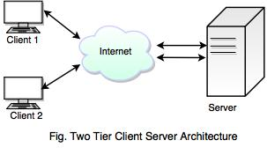
Client-Server: Two-Tier

Slide 45
Client-Server: Two-Tier (cont’d)
Clients are typically “rich” (or ”fat”) (UI + ApplicationLogic + Communication)
Server(s) store data
Each client runs a complete application
Drawbacks: tight coupling between client and server.
Scalability is compromised.

Slide 46
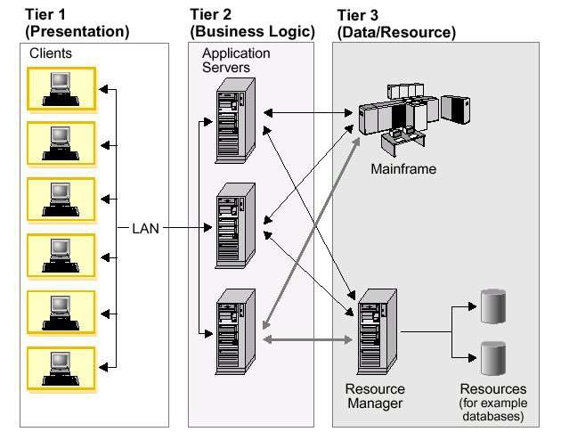
Client-Server: Three-Tier

Slide 47
Client-Server: Three-Tier (cont’d)
Evolved from 2-tier architectures to solve their drawbacks.
A third (middle) tier is inserted between clients and data servers.
Middle tier: Application or business logic.
Scalability improved.

Slide 48
Client-Server: Three-Tier (cont’d)
Other advantages
Clean separation among presentation, application logic, and data storage.
Possibility of adding additional processing layers in the middle layer.
Better isolation of speciﬁcs of the data storage: extensibility, conﬁgurability.

Slide 49
Client-Server Types
Client 1
Client 2
Client N
...
Network
File
Server
Database
Server
Web
Server
Object
Server

Slide 50
Client-Server Types (cont’d)
File Server:
Primitive form of data service.
Useful for sharing files across a network.
The client passes requests for files over the network to the file server.
Database Server:
A computer in a network that is dedicated to database storage and retrieval. It holds the database management system (DBMS) and the databases.
Typically, client passes SQL requests as messages to the DB server; results are returned over the network to the client.
Query processing done by the server.

Slide 51
Client-Server Types (cont’d)
Web Server:
Software and underlying hardware that accepts requests via HTTP (the network protocol created to distribute web content) or its secure variant HTTPS.
A client, commonly a web browser or web crawler, initiates communication by making a request for a web page or other resource using HTTP, and the server responds with the content of that resource or an error message.
A web server can also accept and store resources sent from the user agent if configured to do so.
The hardware used to run a web server can vary according to the volume of requests that it needs to handle. A high-traffic internet website might handle requests with hundreds of servers that run on racks of high-speed computers.

Slide 52
Client-Server Types (cont’d)
Object Server:
Objects work together across machine and network boundaries.
An Object Request Broker (ORB) allows objects to communicate with other across the network.
Interface Definition Languages (IDLs) define interfaces of objects that communicate via the ORB.
ORBs are the evolution of the Remote Procedure Calls (RPC).

Slide 53
RPCs vs. ORBs
call foo
Server
Client
Server
Object X Object Y
Client
Code
Code
Code
call foo
Data
call foo
on
Object X
call foo
on
Object Y
Data
Data
execute foo
RPC Mechanism
Object Request Broker
1) Remote Procedure Call (RPC)
2) Object Request Broker

Slide 54
Client-Server: Advantages/Disadvantages
Advantages
Mix and match heterogeneous platforms.
Transparency of location.
Easy to add new servers or upgrade existing servers.
Distribution of data.
Disadvantages
Performance of the system depends on the performance of the network.
Some client-server systems are tricky to design and implement due to performance requirements.
Unless there is a central register of names and services, it may be hard to find out what services are available.

Slide 55
Start of parenthesis

Slide 56
Client and Server Implementation Using Sockets (Java)

Slide 57
Basics of Programming Using Clients and Servers
Clients and Servers
Server accepts connections from one or more clients
Clients need to connect to server
Identifying a machine
Clients need to know the IP address of server
Identifying a port
Multiple ports exist on each machine
Client and server need to agree on port
Setting up a socket
The actual connection between the client and server
Exchange information using Java streams

Slide 58
InetAddress
In order to use a service, you must be able to find it.
The Java class InetAddress can be used to get/manipulate internet addresses. Methods include
static InetAddress getByName(String host)
static InetAddress getLocalHost()
String getHostAddress()
String getHostName();
Example (see next slide)

Slide 59
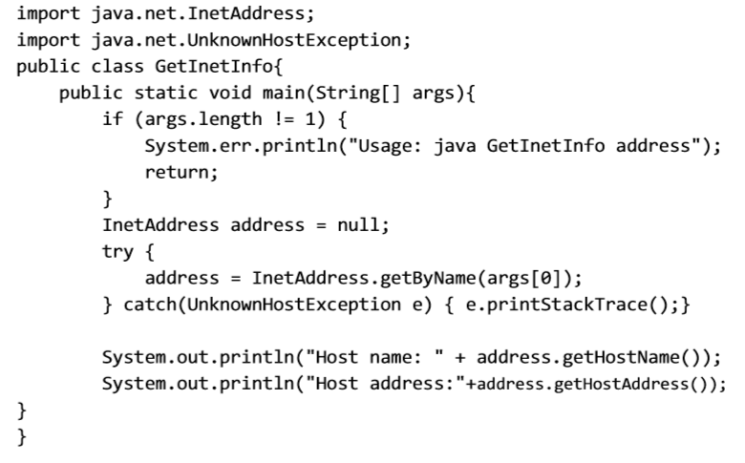
InetAddress – Example

Slide 60
Port Addresses
A service exists on a host and is identified by its port.
A port is a number [1 – 65,535] assigned to a specific process.
To send a message to a server you send it to the port for that service of the host that it is running on.
Certain of these ports are "well known” (e.g., http: 80)
Ports in the region 1-255 are reserved by the IETF (Internet Engineering Task Force). The system may reserve more. User processes (in Unix) may have their own ports above 1023.

Slide 61
Sockets
A socket is a reliable connection for the transmission of data between two hosts.
Sockets isolate programmers from the details of packet encodings, lost and retransmitted packets, and packets that arrive out of order.
A socket programming construct can make use of either the TCP or UDP protocol.
Sockets that use TCP are termed stream sockets, while sockets that use UDP for transport are known as datagram sockets.
There are limits. Sockets are more likely to throw IOExceptions than files, for example.

Slide 62
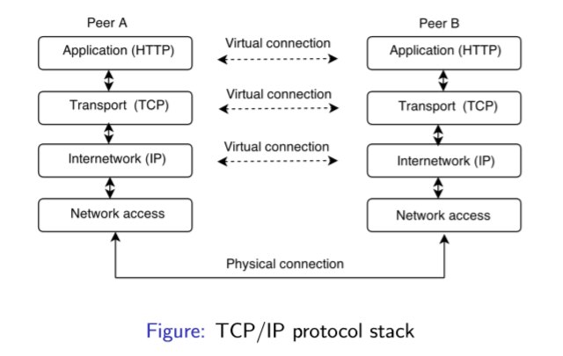
Peer-to-peer Protocol Stacks
The lowest layer (network access) handles communication between two computers
The internet layer handles routing of packets across the network
The transport layer guarantees that packets are error-free and that they are received in the same order as they are sent
The application layer supports application-speciﬁc protocols
E.g. HTTP, SMTP, FTP, ...

Slide 63
Socket Operations
There are four fundamental operations a socket performs. These are:
Connect to a remote machine
Send data
Receive data
Close the connection
A socket may not be connected to more than one host at a time.
A socket may not reconnect after it is closed.

Slide 64
The java.net.Socket class
The java.net.Socket class allows you to create socket objects that perform all four fundamental socket operations.
You can connect to remote machines; you can send data; you can receive data; you can close the connection.
Each Socket object is associated with exactly one remote host. To connect to a different host, you must create a new Socket object.

Slide 65
Sending and Receiving Data
Data is sent and received with output and input streams.
There are methods to get an input stream for a socket and an output stream for the socket.
public InputStream getInputStream() throws IOException
public OutputStream getOutputStream() throws IOException
There's also a method to close a socket:
public synchronized void close() throws IOException

Slide 66
Sending and Receiving Data
Writing Output to a Socket
The getOutputStream() method returns an OutputStream which writes data to the socket.
Most of the time you'll chain the raw output stream to some other output stream or writer class to more easily handle the data.
Reading Input from a Socket
The getInputStream() method returns an InputStream which reads data from the socket.
You can use all the normal methods of the InputStream class to read this data.
Most of the time you'll chain the input stream to some other input stream or reader object to more easily handle the data.

Slide 67
Connection Oriented (TCP)
One process (server) makes its socket known to the system. This will allow other sockets to find it.
It then "listens" on this socket to "accept" any incoming messages.
The other process (client) establishes a network connection to it, and then the two exchange messages.
As many messages as needed may be sent along this channel, in either direction.
The client typically creates a Socket, gets I/O streams from it, and then does consecutive writes and reads.

Slide 68
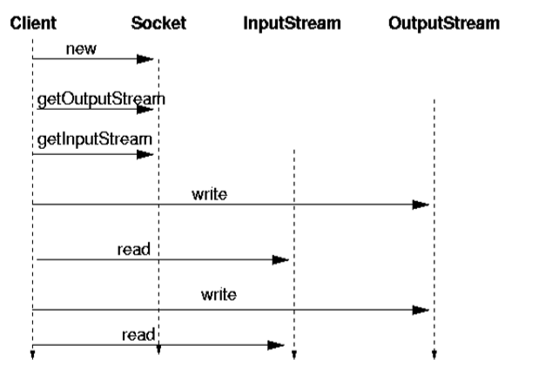
Client

Slide 69
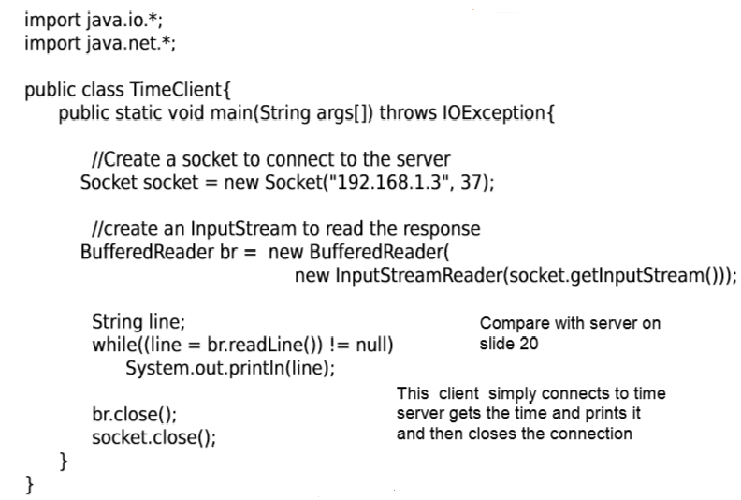
Socket example - TimeClient.java

Slide 70
Server
A server uses a ServerSocket to bind to a port and listens on it.
There are two ends to each connection: the client, that is the host that initiates the connection, and the server, that is the host that responds to the connection.
Clients and servers are connected by sockets.
A server waits for other hosts to connect to it.
When a new client request is accepted, it returns a Socket which is connected to the client.
The server uses this socket to talk to the client, typically reading requests and responding to them.

Slide 71
The java.net.ServerSocket Class
The java.net.ServerSocket class represents a server socket.
A ServerSocket object is constructed on a particular local port. Then it calls accept() to listen for incoming connections.
accept() blocks until a connection is detected. Then accept() returns a java.net.Socket object that performs the actual communication with the client.
There are three constructors that let you specify the port to bind to, the queue length for incoming connections, and the IP address to bind to:
public ServerSocket(int port) throws IOException
public ServerSocket(int port, int backlog) throws IOException
public ServerSocket(int port, int backlog, InetAddress
networkInterface) throws IOException

Slide 72
ServerSocket (cont’d)
Normally you only specify the port you want to listen on, like this:
try {
ServerSocket ss = new ServerSocket(7979);
} catch (IOException e) { System.err.println(e); }
When a ServerSocket object is created, it attempts to bind to the port on the local host given by the port argument.
If another server socket is already listening to the port, then a java.net.BindException, a subclass of IOException, is thrown.
No more than one process or thread can listen to a particular port at a time. This includes non-Java processes or threads.
For example, if there's already an HTTP server running on port 80, you won't be able to bind to port 80.
On Unix systems (but not Windows or the Mac) your program must be running as root to bind to a port between 1 and 1023.
0 is a special port number. It tells Java to pick an available port.

Slide 73
Reading data with a ServerSocket
ServerSocket objects use the accept() method to connect to a client.
There are no getInputStream() or getOutputStream() methods for ServerSocket.
accept() returns a Socket object, and its getInputStream() and getOutputStream() methods provide streams.
Example
try {
ServerSocket ss = new ServerSocket(2345);
Socket s = ss.accept();
PrintWriter pw = new
PrintWriter(s.getOutputStream());
pw.println("Hello There!");
pw.println("Goodbye now.");
s.close();
} catch (IOException e) { System.err.println(e); }

Slide 74
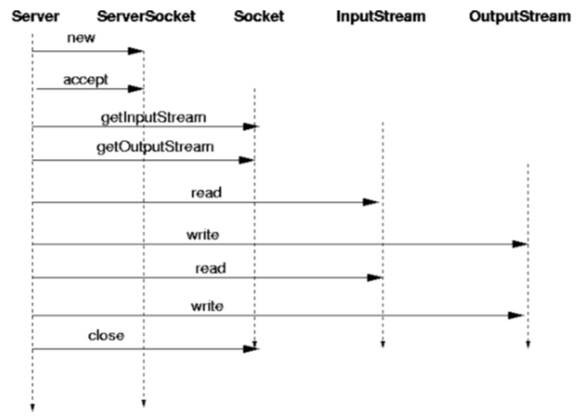
Server

Slide 75
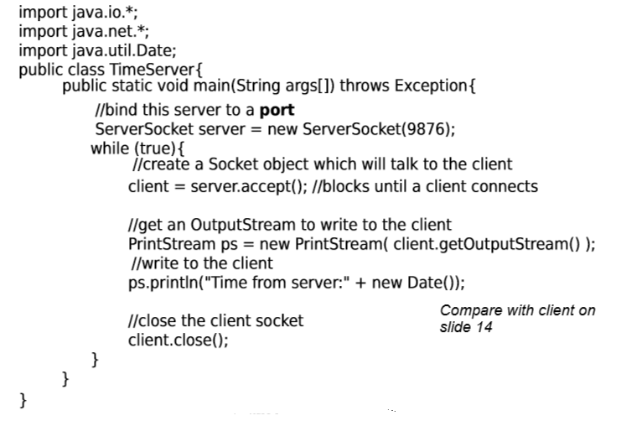
ServerSocket - TimeServer.java

Slide 76
Timeout
The server may wish to timeout a client if it does not respond quickly enough, i.e., does not write a request to the server in time. This should be a long period (several minutes), because the users may be taking their time.
The client may want to timeout the server (after a much shorter time).
try {
socket.setSoTimeout(10000); // 10 seconds
} catch(SocketException e) { e.printStackTrace(); }
Staying alive: A client may wish to stay connected to a server even if it has nothing to send. It can setKeepAlive(true) on the socket

Slide 77
Handling Multiple Clients
The TimeServer example above handles one client at a time – this can cause delay and waiting for client if there are many clients to be serviced
All types of servers need to be highly threaded – to handle multiple concurrent clients
To handle multiple clients
In the server, create a thread for each client
Pass socket to constructor of thread so that thread has access to (client) socket
No difference in client, the client does not know that there are many other clients being serviced concurrently

Slide 78
Why Multi Thread the Servers?
When a client sends a request to the server, the server accepts the request, does some processing and sends a response back to the client.
Processing can take time and the server is blocked during processing. Any other request to the server is denied until the server completes the current request. This can lead to timeouts and disconnects by other clients which are in the queue.
A multithreaded server can handle many requests at a time without blocking and gives reasonable response time to clients.
Threads allow server to handle many requests concurrently.
Threading makes servers scalable.

Slide 79
How to Multi Thread a Server
Server program is now divided to into parts:
The main thread which listens for connections from the clients, and
The request handler – the thread which actually services the client request.
The main thread listens for and accepts connections. Whenever a client connects, a new thread is created to handle the client request. This new thread handles processing the request and communication with the client.
The main thread does not block and continues listening for connections.
The main thread and the service threads run concurrently.
In actual use servers use thread pools instead of creating new threads on the fly.

Slide 80
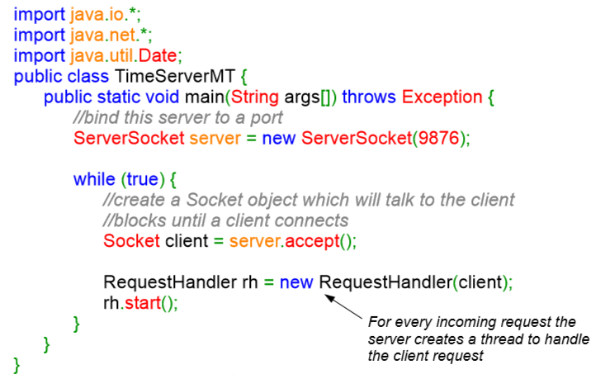
Multithreading a Server Example – Time Server

Slide 81
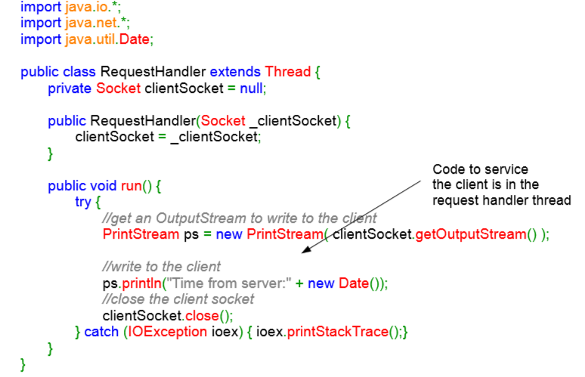
Multithreading a Server – the Request Handler

Slide 82
Objects Over Sockets
Object serialization works for sockets as well.
Clients can send object to the servers and servers can respond with objects.
This is better than dealing with raw data using bytes etc.
Also, when you have lot of structured data (e.g., student records) it is better to send as a collection of objects since this can be used directly in the program without much conversion.

Slide 83
Java Object Serialization (cont’d)
The Java API supports transport of objects over the socket connection. This capability comes from two classes in the java.io package: ObjectInputStream and ObjectOutputStream.
The ObjectOutputStream has the following methods:
public ObjectOutputStream(OutputStream os);
public final void writeObject(Object o);
The ObjectInputStream has the following methods: public ObjectInputStream(InputStream is); public final Object readObject();

Slide 84
Objects Over Sockets (cont’d)
Objects are read and written from socket input and output streams respectively.
A client creates a serializable object and writes to the output stream of the socket using the writeObject() method of the ObjectOutputStream.
A server creates an input stream and retrieves the object using the readObject() method of the ObjectInputStream.
A client receives the server response also as an object. To retrieve the response object the client uses the readObject() method of the ObjectInputStream.
The readObject() method always returns an instance of java.lang.Object – which is the parent class of all classes in Java. You must cast it to the required object.

Slide 85
End of parenthesis

Slide 86
Layered Style
Hierarchical system organization
Each layer exposes an interface (API) to be used by above layers
“Multi-level client-server”
Each layer acts as a
Server to layers “above”
Client to layer(s) “below”
Components are typically collections of procedures.
Connectors are typically procedure calls under restricted visibility.
Example: operating systems
Virtual machine style results from fully opaque layers

Slide 87
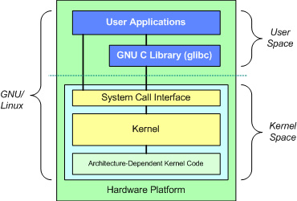
The Layered Structure of an OS

Slide 88
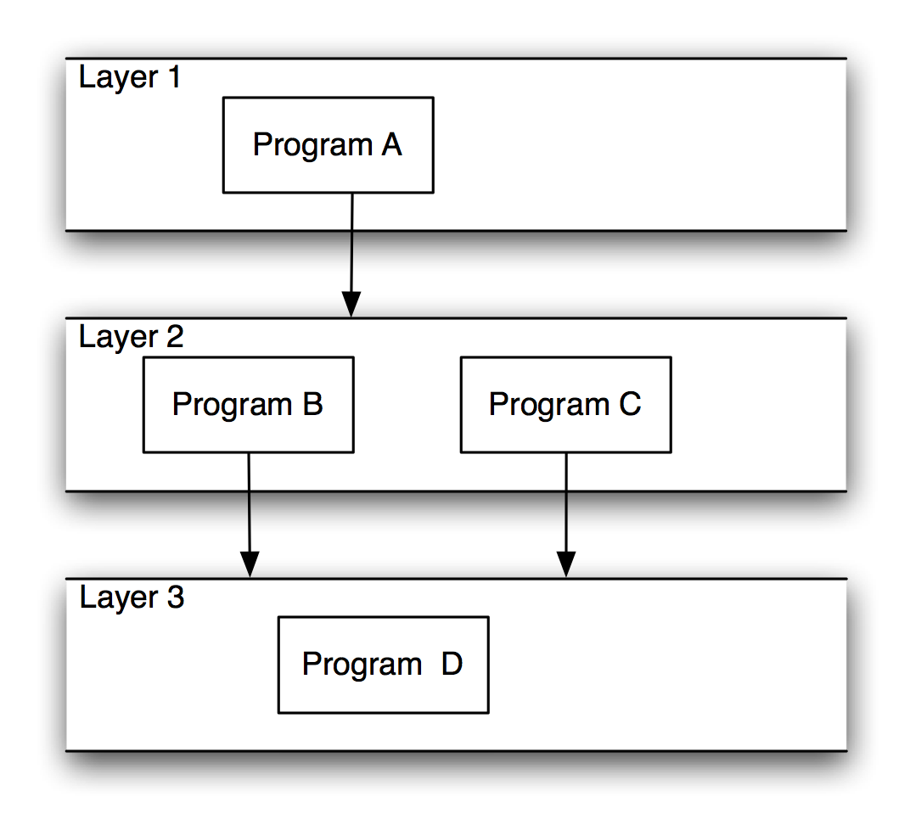
Layered Systems
Strict Layering
Non-strict Layering

Slide 89
Advantages/Disadvantages
Advantages
Clear dependence structure benefits evolution
Lower layers are independent from the upper layers
Upper layers can evolve independently from the lower layers as long as the interface semantics are preserved.
Reuse
Standardized layer interfaces for libraries and frameworks.
Disadvantages
Not all systems are easily structured in layers.
Performance requirements may force the coupling of high-level functions to their lower-level implementations.
Suitable for applications that involve distinct classes of services that can be organized hierarchically.

Slide 90
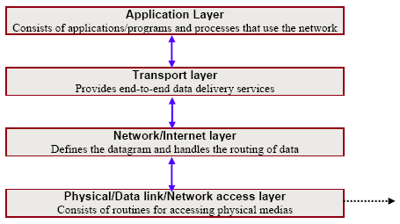
Example: The Layered Structure of TCP/IP

Slide 91
Dataflow Styles
Pipe and Filter

Slide 92
Data Flow Systems
Data flow systems are decomposed around the central theme of transporting data (or data streams) and transforming the data along the way to meet application-specific requirements.

Slide 93
Pipe and Filter Style
Components are filters
Transform input data streams into output data streams
Possibly incremental production of output
Connectors are pipes
Conduits for data streams
Example: ls invoices | grep -e August | sort
Style invariants
Filters are independent (no shared state)
Filter has no knowledge of up- or down-stream filters

Slide 94
Pipe and Filter Style (cont’d)
Examples
UNIX shell
Traditional compilers
Variations
Named pipes — pipes beyond stdin / stdout
Bounded pipes — limited amount of data on a pipe

Slide 95
Pipe and Filter Style (cont’d)
filters
pipes

Slide 96
Pipe and Filter Style (cont’d)
filter
pipes

Slide 97
Advantages / Disadvantages
Advantages
Easy to understand: system behavior is a succession of component behaviors
Filter addition, replacement, and reuse
Possible to hook any two filters together
Concurrent execution
Disadvantages
Interactive applications
Excessive parsing and unparsing leads to loss of performance.

Slide 98
When to use it
Use it when:
Filters already exist and are useful in more than one application
Avoid it when:
Interaction between components is required

Slide 99
Example: Compiler Architecture
One aspect of compiler architecture is based on the model of a sequential pipeline:
text
Lex
Syn
Sem
Opt
CGen
code

Slide 100
Example: Face Identity Application
Assume we have the following software components that help us identify the identity of an individual in a video clip:
A s/w component that accesses videos (with audio) from YouTube (YoutubeManager).
A s/w component that determines if a face is in the video (FaceDetection).
A s/w component that detects the identity of the person from the detected face (FaceRecognition).
A s/w component that produces a report of the results (IdenityManager).
What does a possible architecture look like for a s/w application that processes videos and identifies faces?

Slide 101
Example: Face Identity Application (cont’d)
Transformed data containing only the information from detected faces!
Big video file!
Transformed data containing only the results from the recognition process, e.g., a report of identity!
Wanted!
Youtube Manager
Face Detection
Face Recognition
Identity Manager
Joe Developer
Wanted!

Slide 102
Shared Memory Styles
Blackboard
Rule-based / Expert System

Slide 103
Blackboard Style
Two kinds of components
Central data structure — blackboard
Components operating on the blackboard
System control driven by the blackboard state
Examples
Compiler architecture
Integrated programming environments
AI systems

Slide 104
Blackboard Style (cont’d)
Memory Access
Computation
Shared Data
Memory

Slide 105



Blackboard Style (cont’d)
Agents cannot access blackboard until access is granted by controller.
The actual blackboard. In this example, this is the data repository
Controller
Agent 4 waits for his turn
Agent 3 waits for his turn
Agent 1
Access to the blackboard has been granted to Agent 1
Agent 2 waits for his turn
Agent 1 advances the solution!

Slide 106
Example of Blackboard Style
Consider the design a university s/w system that manages student registrations.
Registrations are managed based on:
Course availability
Student’s course history
Student’s work schedule
Goal is to maximize both the number of courses taken and hours worked.

Slide 107
Example: Architectural Components
ScheduleManager
Manages access to the ScheduleBlackboard and controls the problem-solving process.
StudentHistory
Knowledge source for student’s course history and other preferences.
WorkSchedule
Knowledge source for student’s work schedule
CourseOfferings
Knowledge source for university’s course offerings
ScheduleBlackboard
Central data store where elements of the solution space are stored

Slide 108
Example: Approach
The ScheduleManager initializes all other components.
The StudentHistory component is activated to retrieve a student’s course history and preferences.
This information is stored in the ScheduleBlackboard component.
The CourseOffering component is activated to search for the particular term’s course offering.
This information is used to create a schedule consistent with the student’s preferences and course offerings.
The WorkSchedule component is activated to determine the student’s federal-work study schedule.
This information is used to modify the schedule accordingly.
Process may be repeated until the schedule provides the best possible solution

Slide 109
Blackboard Style (cont’d)
Specializations:
Data structure in memory.
Data structure on disk.
Changes to the data structure trigger computations
Concurrent computations and data access

Slide 110
Blackboard Style (cont’d)
Advantages:
Efficient way to store “large” amount of data.
Sharing model is published as the repository schema.
Centralized management of data.
Disadvantages:
Must agree of a data model a priori.
Difficult to distribute data.
Data evolution is expensive.

Slide 111
When to use it
Use it when:
All calculation centers on a common data structure.
Order of processing dynamically determined and data-driven.
Avoid it when:
Programs deal with independent parts of the common data.
Interface to common data susceptible to change.
When interaction between programs require complex regulation.

Slide 112
Example: Hybrid Compiler Architectures
Lex
Syn
Sem
Opt
Cgen
Attributed
Parse Tree
Symbol Table
Edit
Flow

Slide 113
Rule-Based/Expert System Style
A highly specialized type of shared memory architecture.
Inference engine parses user input and determines whether it is a fact/rule or a query.
If it is a fact/rule, it adds this entry to the knowledge base.
Otherwise, it queries the knowledge base for applicable rules and attempts to resolve the query.
“shared” memory
User
Interface
Inference
Engine
Knowledge
Base

Slide 114
Rule-Based Style (cont’d)
Components: User interface, inference engine, knowledge base
Connectors: Components are tightly interconnected, with direct procedure calls and/or shared memory.
Data Elements: Facts and queries
Behavior of the application can be very easily modified through addition or deletion of rules from the knowledge base.
Caution: When a large number of rules are involved understanding the interactions between multiple rules affected by the same facts can become very difficult.

Slide 115
When to use it
Use it when:
Problem data and queries expressible as simple rules over which inference may be performed.
Avoid it when:
Number or rules is large.
There is interaction between rules
High-performance is required.

Slide 116
Interpreter Styles
Interpreter
Mobile Code

Slide 117
Interpreter Style
An interpreter is a program capable of parsing and executing statements written in some other programming language.
Essentially, an interpreter creates a virtual machine.
Therefore, the interpreter style is suitable for applications in which the most appropriate language or machine for executing the solution is not directly available.

Slide 118
Interpreter Style Examples
Programming Language Translators:
Java
Python
Command Language Processors:
Unix shell
Scripting Languages:
Awk
Perl
Rule Based Systems:
Prolog
Coral

Slide 119
Interpreter Style (cont’d)
Components: include one state machine for the execution engine and three memories:
current state of the execution engine
program being interpreted
current state of the program being interpreted
Connectors:
procedure calls
direct memory accesses.

Slide 120
Interpreter Style (cont’d)
Memory
Current State
of
Program Being
Interpreted
Program
Being
Interpreted
inputs
Computation
State Machine
store
Execution
Engine
selected
instruction
Current
State of
Execution
Engine
outputs
Selected
data (fetch)

Slide 121
Interpreter Style (cont’d)
Advantages
Simulation of non-implemented hardware.
Facilitates portability of applications across a variety of platforms.
Disadvantages
Extra level of indirection slows down execution.

Slide 122
Java Architecture (cont’d)
Java
Source
Code
Java
Compiler
Java Virtual
Machine
Java
Bytecode
Operating
System

Slide 123
Java Architecture (cont’d)
Java
Source
Code
Bytecode
Verifier
Class
Loader
Java
Compiler
INTERNET
Java Virtual Machine
Just In Time
Compiler
Java
Bytecode
Operating System

Slide 124
Mobile-Code Style
Code Mobility: The capability to reconfigure dynamically (at runtime) the binding between the software components of the application and their physical location within a computer network.
Components: “Execution dock”, which handles receipt of code and state; code compiler/interpreter.
Connectors: Network protocols and elements for packaging code and data for transmission.
Data Elements: Representations of code as data; program state; data.
Variants:
Code-on-demand
Remote execution/evaluation
Mobile agent

Slide 125
Mobile-Code Style (cont’d)
Code-on-demand:
The client has resources but does not have the code that needs to be executed.
It sends a request to a remote server for the code, receives that code, and executes it locally.
Example: javascript code is downloaded from a server and then executed locally.

Slide 126
Mobile-Code Style (cont’d)
Remote execution/evaluation:
The client has the code but lacks the resources (e.g., the interpreter, CPU cycles, etc.) to execute the code.
The client sends the code to a server component at the remote site, which in turn executes the code using the resources available there.
The results of that execution are then sent back to the client.
Remote execution assumes that the provided code will be executed in a sheltered environment, such that it won't impact other clients of the same server aside from the resources being used.
Example: A website where people practice their programming skills.

Slide 127
Mobile-Code Style (cont’d)
Mobile agent:
Agent: A program that can ship itself to another computer on the network and continue execution at the new computer.
Can autonomously decide to migrate to a different node to obtain additional resources.
An entire computational component is moved to a remote site, along with its state, the code it needs, and possibly some data required to perform the task.
Example: Collecting information spread across computers on a network.
A network backup tool that must look at every disk attached to every computer on the network and collect information about the backup status of each disk.
Example: A computer virus

Slide 128
Mobile Code Style: Security Concerns
Code being executed might be malicious.
Privacy invasion
Denial of service
Solutions
Sandboxing
Mobile code runs only in a restricted environment, “sandbox”, and does not have access to vital parts of the system.
Signing
Only mobile code signed by a trusted party can be executed.

Slide 129
When to use it
Use it when:
You want to reduce network load
Move the computation to the data processing rather than the data to the computation.
You need to overcome network latency.
Avoid it when:
Security of mobile code cannot be assured or sandboxed.
When tight control of versions of deployed software is required.

Slide 130
Implicit Invocation Styles
Publish and Subscribe
Event-based

Slide 131
Implicit Invocation Styles
Instead of invoking a method or procedure directly ...
A component can announce (or broadcast) one or more events.
Other components in the system can register an interest in an event by associating a procedure with the event.
When an event is announced, the broadcasting system (connector) itself invokes all of the procedures that have been registered for the event.

Slide 132
Implicit Invocation Styles (cont’d)
Suitable for applications that involve loosely-coupled collection of components, each of which carries out some operation and may in the process enable other operations.
Particularly useful for applications that must be reconfigured “on the fly”:
Enabling or disabling capabilities.

Slide 133
Advantages / Disadvantages
Advantages:
Provides strong support for reuse
any component can be introduced into a system simply by registering it for the events of that system.
Eases system evolution
components may be replaced by other components without affecting the interfaces of other components in the system.
Disadvantages:
When a component announces an event:
It has no idea what other components will respond to it
It cannot rely on the order in which the responses are invoked
It cannot know when responses are finished

Slide 134
Publish-Subscribe Style
Subscribers register/deregister to receive specific messages or specific content.
Publishers broadcast messages to subscribers either synchronously or asynchronously.
Components: Publishers, subscribers, proxies for managing distribution.
Connectors: Typically, a network protocol is required. Content-based subscription requires sophisticated connectors.
Data Elements: Subscriptions, notifications, published information.
Topology: Subscribers connect to publishers either directly or may receive notifications via a network protocol from intermediaries.

Slide 135
Advantages/Disadvantages
Advantages
Subscribers are independent from each other.
Very efficient one-way information dissemination.
Disadvantages
Need special protocols to deal with very high numbers of subscribers.

Slide 136
Event-Based Style
Independent components asynchronously emit and receive events communicated over event buses.
Components: Independent, concurrent event generators and/or consumers.
Connectors: Event buses (at least one)
Data Elements: Events – data sent as a first-class entity over the event bus.
Topology: Components communicate with the event buses, not directly to each other.
Variants: Component communication with the event bus may either be push or pull-based.
Highly scalable, easy to evolve, effective for highly distributed applications.

Slide 137
Advantages/Disadvantages
Advantages
Scalable
Easy to evolve (just add another component)
Components can be heterogeneous (as long as they can communicate with the event bus)
Disadvantages
No guarantee when the even will be processed

Slide 138
When to use it
Use it when:
Components are concurrent and independent.
Components heterogeneous and network-distributed.
Avoid it when:
Guarantees on real-time processing of events is required.

Slide 139
Peer-to-peer Style

Slide 140
Peer-to-Peer Style
A peer-to-peer system consist of a network of interconnected nodes (“peers”).
Tasks or work loads are partitioned between peers.
Peers are equally privileged, equipotent participants in the application.
Peers make a portion of their resources, (e.g., processing power, disk storage) directly available to other network participants, without the need for central coordination by servers or stable hosts.
Peers are both suppliers and consumers of resources, (in contrast to the traditional client-server model).

Slide 141
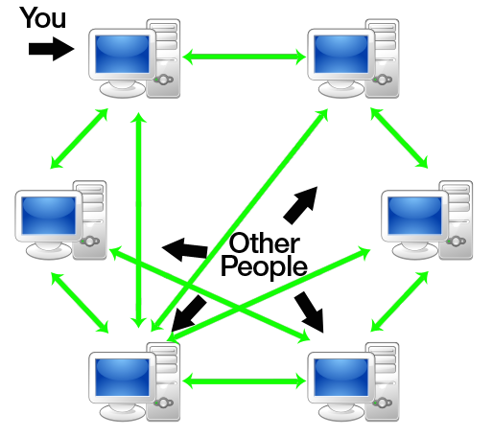
Peer-to-Peer Style (cont’d)

Slide 142
Peer-to-Peer Variations
Centralized P2P
Some aspects are centralized
For example, a central component keeps track of the available peers ⇒ Centralized peer to peer
Hybrid P2P
Not all peers are equal, some have additional responsibilities
They are called supernodes ⇒ Hybrid peer to peer
Example: Skype uses a peer-to-peer protocol, but also uses supernodes and a central login servers

Slide 143
Peer-to-Peer Style
Provides little structure for a system.
Peers: Independent components, having their own state and control thread.
Connectors: Network protocols, often custom.
Data Elements: Network messages.
Topology: Network (may have redundant connections between peers); can vary arbitrarily and dynamically.

Slide 144
Peer-to-Peer Style (cont’d)
Supports decentralized computing with flow of control and resources distributed among peers.
Highly robust in the face of failure of any given node.
Scalable in terms of access to resources and computing power.
But caution on the protocol!

Slide 145
When to use it
Use it when:
Peers are distributed in a network, can be heterogeneous, and mutually independent.
Robust in face of independent failures.
Highly scalable.
Avoid it when:
Trustworthiness of independent peers cannot be assured or managed.
Resource discovery inefficient without designated nodes.

Slide 147
Distributed Objects: CORBA
The Common Object Request Broker Architecture (CORBA) is a standard distributed object architecture developed by the Object Management Group (OMG) consortium.
“Objects” (coarse- or fine-grained) run on heterogeneous hosts, written in heterogeneous languages.
Objects provide services through well-defined interfaces.
Distributed objects in a CORBA system communicate by sending messages to each other.
Objects invoke methods across host, process, and language boundaries via remote procedure calls (RPCs).

Slide 148
Distributed Objects: CORBA (cont’d)
Components: Objects (software components exposing services through well-defined provided interfaces)
Connector: (Remote) Method invocation
Data Elements: Arguments to methods, return values, and exceptions
Topology: General graph of objects from callers to callees.
Additional constraints imposed:
Data passed in remote procedure calls must be serializable.
Callers must deal with exceptions that can arise due to network or process faults.
Location, platform, and language “transparency”.

Slide 149
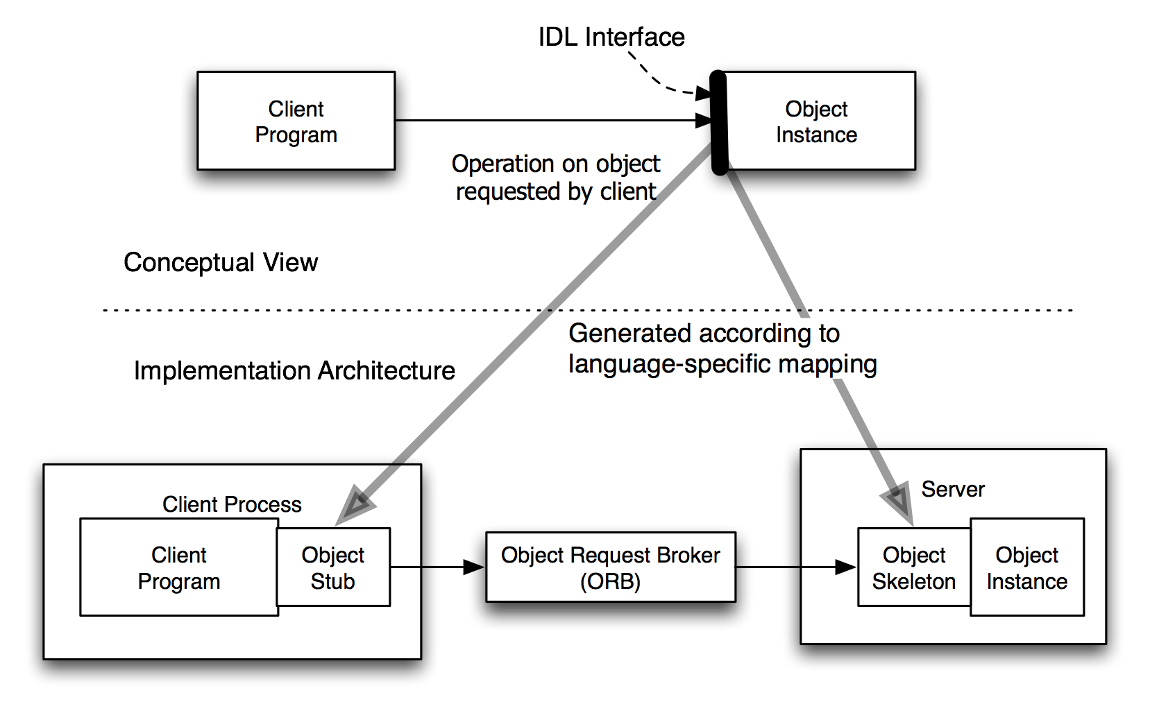
CORBA Concept and Implementation
Software Architecture: Foundations, Theory, and Practice; Richard N. Taylor, Nenad Medvidovic, and Eric M. Dashofy; © 2008 John Wiley & Sons, Inc. Reprinted with permission.

Slide 150
CORBA Method Request
Object Reference
Servant
Client
Server
Stubs
Skeletons
ORB
ORB
Network Message
(TCP/IP,...)
Method Requests

Slide 151
CORBA Method Request (cont’d)
The Figure shows how a message from a client object is sent to a server object.
In order for a client to access a server object, it must first obtain a handle (object reference) to that object.
If the server object is remote, the handle points to a stub function, which uses the Object Request Broker (ORB) service to forward invocations to the server object.

Slide 152
CORBA IDL and IIOP
The client may only invoke methods that are specified in the CORBA object’s interface.
Object interfaces are defined using an Interface Definition Language (IDL).
A programming language and platform neutral notation for specifying interfaces.
IDL compilers target specific platform and programming language combinations (e.g., C++ on Windows).
Generates two artifacts:
Object stub
Object skeleton
Different ORBs communicate via the Internet InterORB Protocol (IIOP).

Slide 153
Object Stubs
Object Stubs:
An object that provides implementations for each method in the IDL interface.
Method implementations do not actually perform the services provided by the true object.
The stub serializes and sends the calling parameters across machine or process boundaries to the object skeleton.
The stub receives the return information from the skeleton and returns it to the caller.

Slide 154
Object Skeletons
Object Skeletons:
An object that provides empty implementations for each method defined in the IDL interface.
The skeleton code transforms the call and parameters into the required implementation-specific format before calling the object.

Slide 155
Server Objects in CORBA
The server-side ORB receives the request over a network connection and then determines which of the objects on its machine is the target.
When the ORB locates the object, it must prepare it to receive the request. E.g.,
Start a server process that contains the object.
Retrieve the object from persistent storage.

Slide 156
Hiding Services Behind an Object Adapter
S1
S2
S3
S4
Adapter
(CORBA OBJECT)
ORB

Slide 157
Object Adapters in CORBA
The Figure shows how an adapter can act as a proxy between a set of services and the ORB.
Clients will access each service through the adapter that is responsible for that service.
The adapter will be responsible for finding the appropriate filters to handle each client request.

Slide 158
Object Adapters in CORBA (cont’d)
These filters may be:
on the same machine as the adapter, or
may be on another machine, in which case the adapter must delegate the client request to another adapter.

Slide 159
When to use it
Use it when:
Objective is to preserve illusion of location-transparency.
Avoid it when:
High overhead of supporting middleware is excessive.

Slide 160
Observations
Different styles result in
Different architectures
Architectures with greatly differing properties
A style does not fully determine resulting architecture
A single style can result in different architectures
Considerable room for
Individual judgment
Variations among architects
A style defines domain of discourse
About problem (domain)
About resulting system

